Slide 1

Direct Absorbance Bilirubin Spectrometer
(DABS)
Group 4
Bernardin Dezius, CpE
Juan Gonzalez, EE
Kevin Kuzius, EE
Kevin Landau, PSE
Andrea Wetteland, PSE

Slide 2
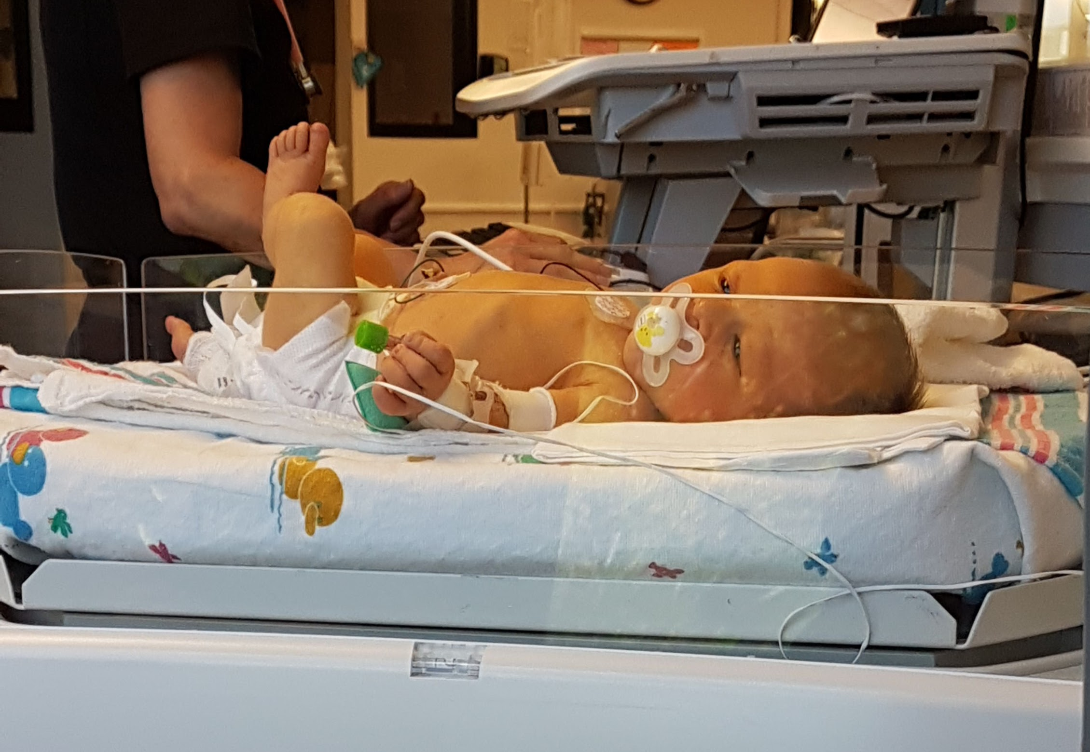
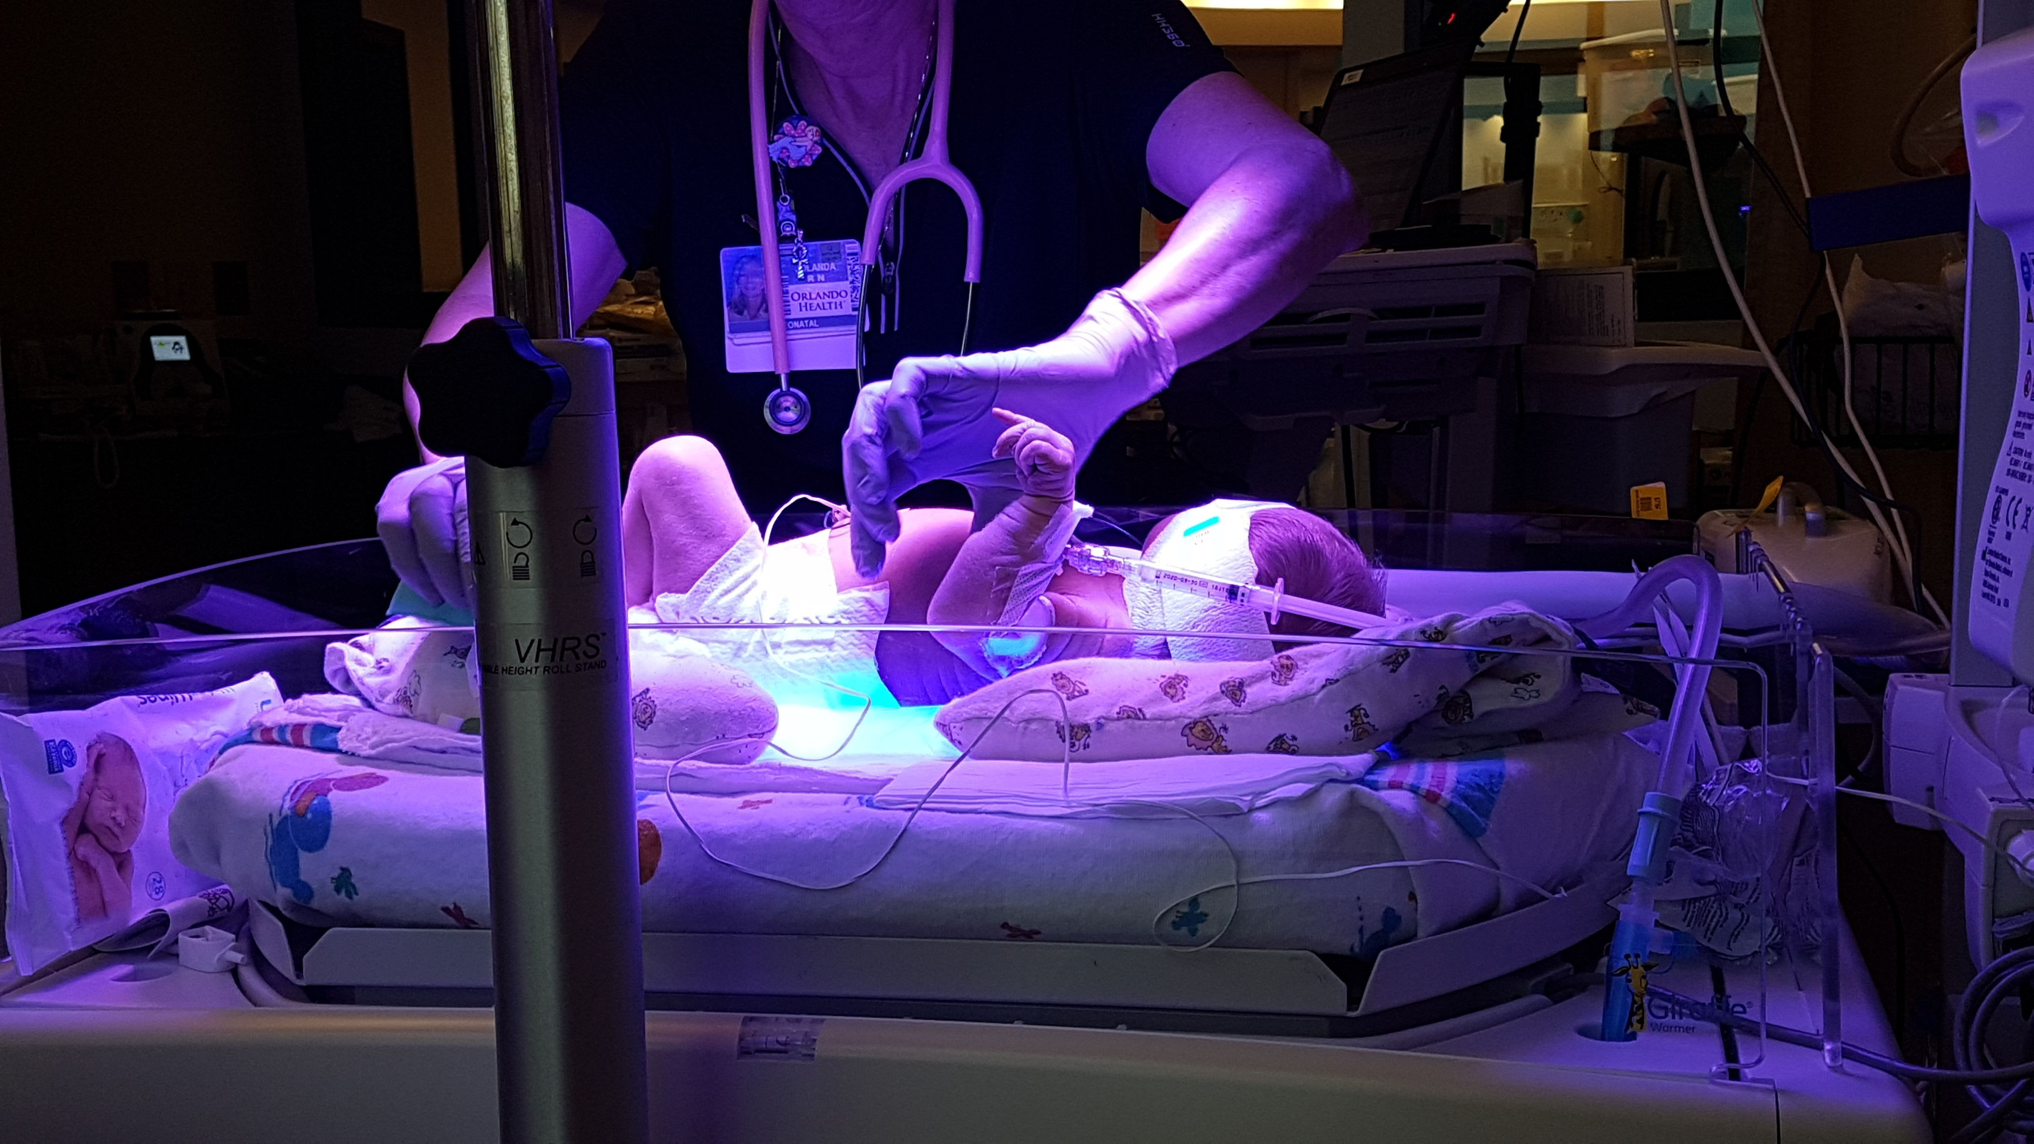
Motivation
Jaundice afflicts up to 60% of all newborns.
Build-up of bilirubin in the blood that the newborn's liver can't efficiently filter
Causes yellowing of eyes and skin
Most cases are mild and can be treated with exposure to sunlight.
Higher levels can cause brain damage if not treated.

Slide 3
Goals & Objectives
The goal of this project is to provide a quick, safe, and cost-effective medical tool in determining high levels of bilirubin in newborns.
DABS device is for clinical use that can quickly determine the severity of jaundice based on the absorbance of bilirubin in a blood sample within seconds.

Slide 4
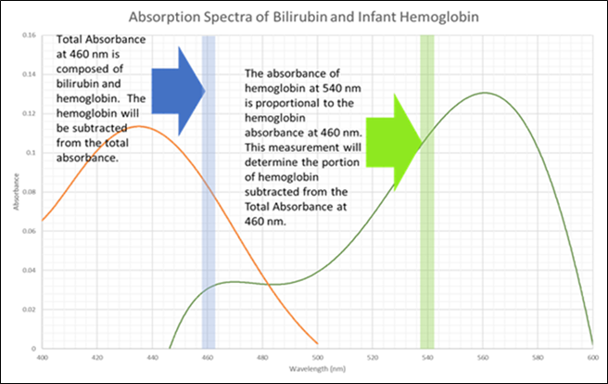
Executive Summary
•Bilirubin and hemoglobin contribute to the absorption measured with a blue wavelength.
•Only hemoglobin contributes to the absorption at 540 nm.
•Based on hemoglobin and oxygen levels in a normal, full-term neonate, the hemoglobin absorption at 540 nm can determine the amount of absorption is due to hemoglobin at 460 nm.

Slide 5
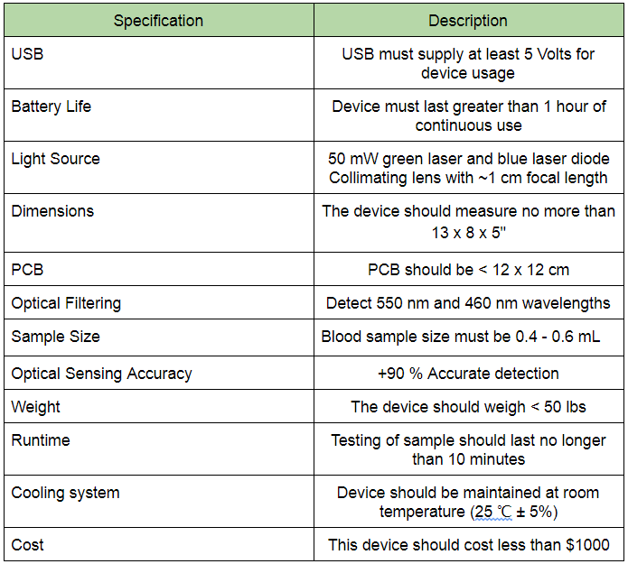
Specifications

Slide 6
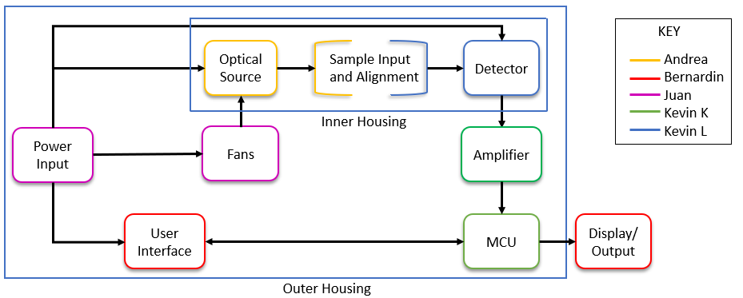
Block Diagram

Slide 7
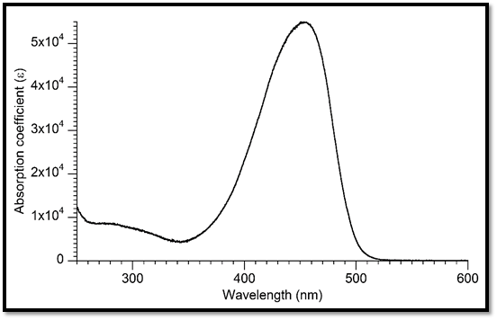
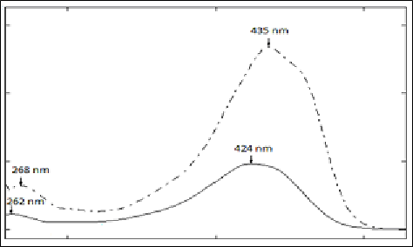
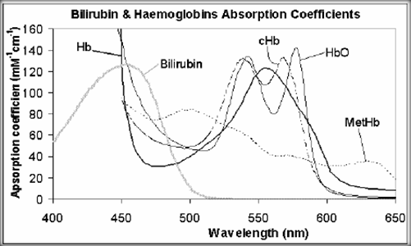
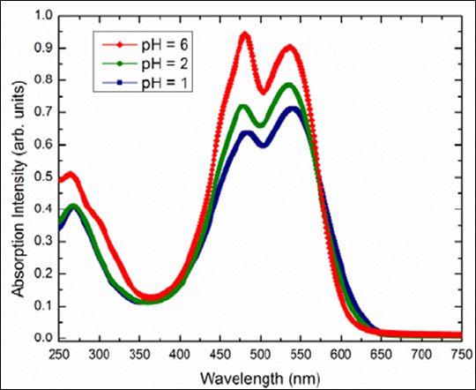
Proxy Samples
Bilirubin
Curcumin
Hemoglobin
Betalain

Slide 8
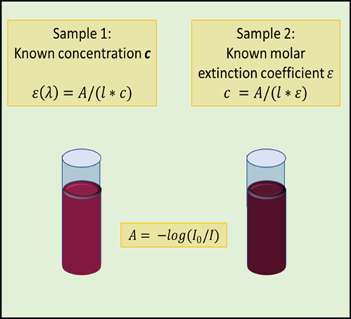
Calculating Concentration
• Beer-Lambert Law
A = lcε = -log(I₀/I_{T})
• Comparison of incident (blank) to transmitted
• Hold separate curcumin and betalain concentrations constant to find ε for each wavelength.
• Use ε coefficients to calculate unknown concentrations

Slide 9
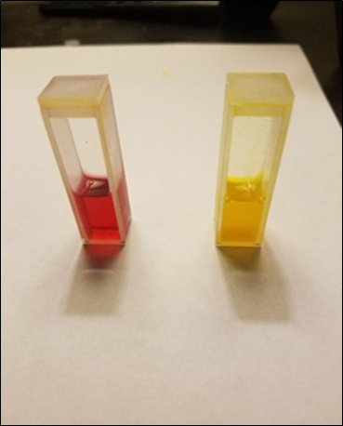
Sample Preparation
Concentrations must be consistent
Powdered beetroot and turmeric dissolved in methanol for greatest accuracy
Time constraints include photosensitivity of dies and sediment

Slide 10
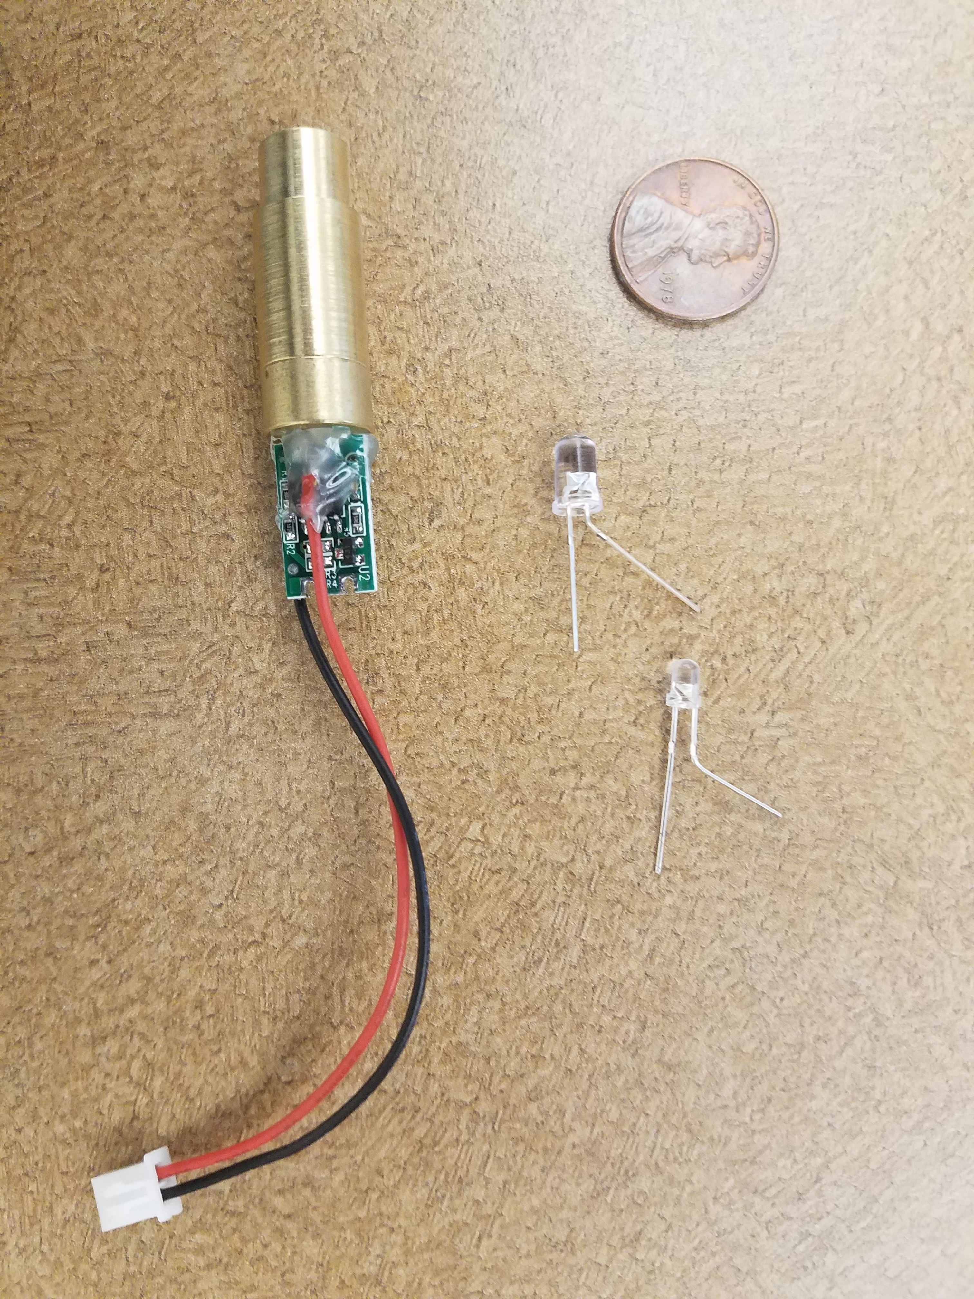
Light Sources
Requirements
•Power requirements: ~4 V
•Power output: 5-50 mW
•Wavelength output: ~460 nm, ~550 nm, with low FWHM
•Low-cost
Laser Diodes vs LEDs
•LEDs cheaper, more efficient
•Laser diodes have much narrower FWHM range

Slide 11
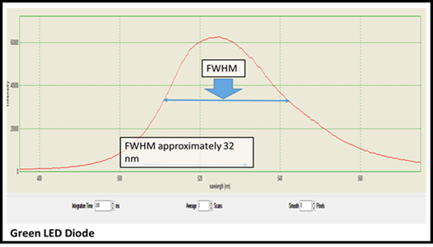
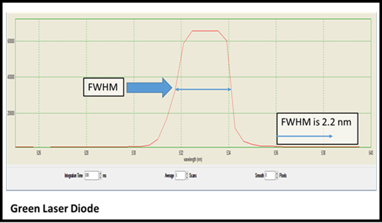
FWHM Spectral Emissions
•A wide spectral width makes it almost impossible to attribute amounts of absorption to specific wavelength ranges.
•Equal and specific spectral widths for each wavelength are necessary to accurately determine absorption

Slide 12
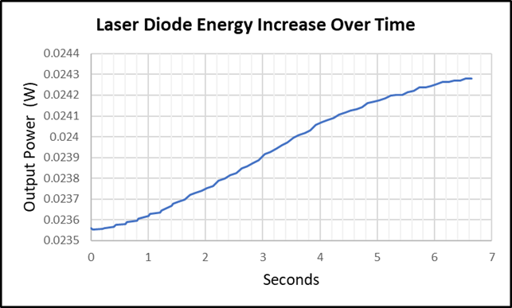
Lasers – Temperature Requirements
•The power output be same for the blank and the transmitted readings
•Reading at 1 sec before slope begins to increase
•Purpose of fan to mitigate this temperature increase

Slide 13
Detector
Convert optical signal to an electrical signal
High sensitivity
Spectral range that includes 460 nm and 550 nm
Linear response
Use Beer-Lambert Law to calculate the concentration of the desired substance

Slide 14
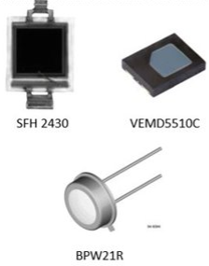
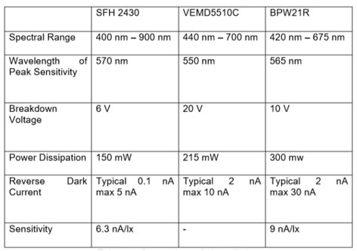
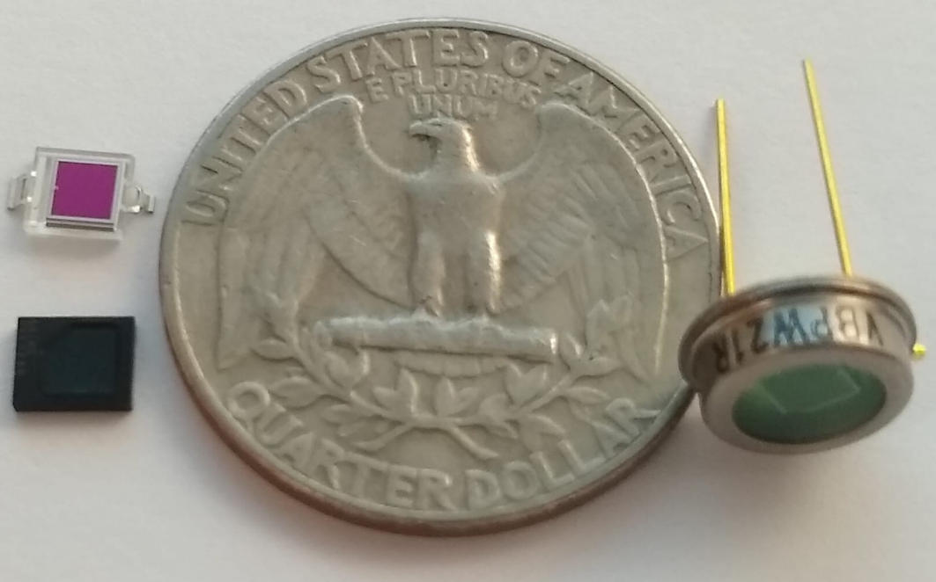
Detector Comparison
Size Comparison

Slide 15
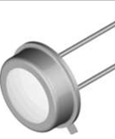
Detector – BPW21R
•This detector had the highest sensitivity (9 nA/lx) and a narrow spectral range
•Linear response
•Ease of use for testing and implementation into the circuit
•Larger radiant sensitive area 7.5 mm² as opposed to 7.02 mm²

Slide 16
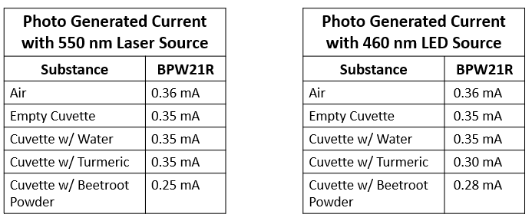
Proof of Concept

Slide 17
Microcontroller Technology Comparison
Parameter | MSP430FR6989 | MSP432P4111 | ARM Cortex-M3
GPIO | 63 programmable (80pin) 83 programmable (100pin) | 84 programmable | 54 Digital 12 Analog Input 2 Analog Output
ADC Resolution | 12 Bit | 16 Bit | 12 Bit
Clocking Features | 16 MHz (max) | 48 MHz (max) | 84 MHz (max)
Memory (Flash) | 128 KB | 2048 KB | 512 KB

Slide 18
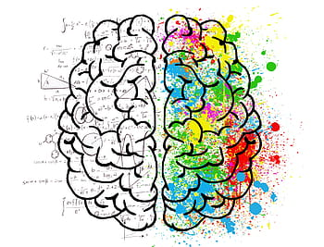

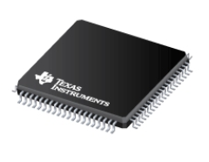
Microcontroller
Coordinates all operations
Stops modules from conflicting and wasting power
Low-power modes
Actual Size: 14mm x 14mm
Texas Instruments
Notes:
CPU, MCLK, DCO, SMCLK, ACLK

Slide 19
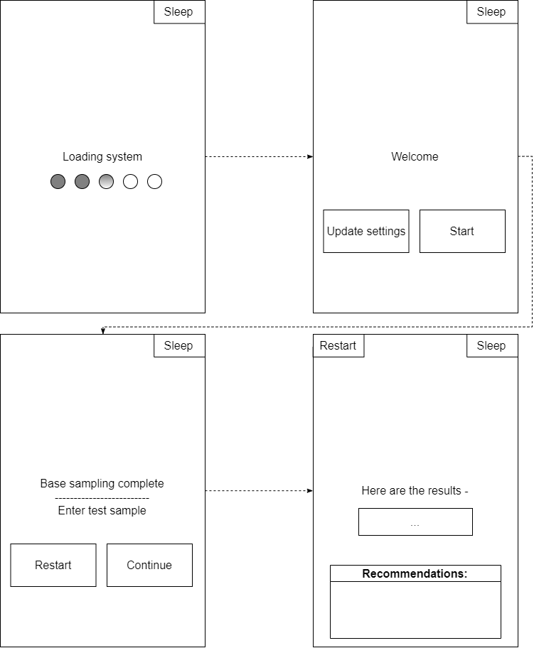
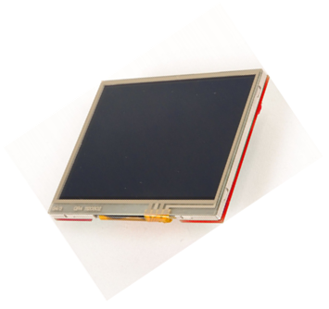
User Interface
BOOSTXL-K350QVG-S1

Slide 20
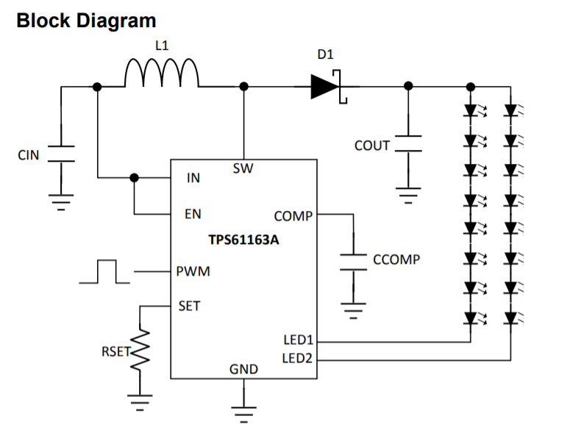
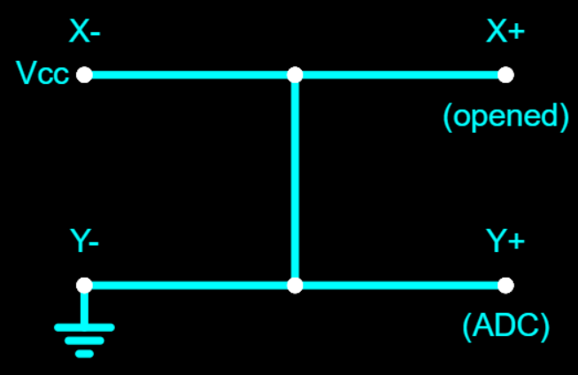
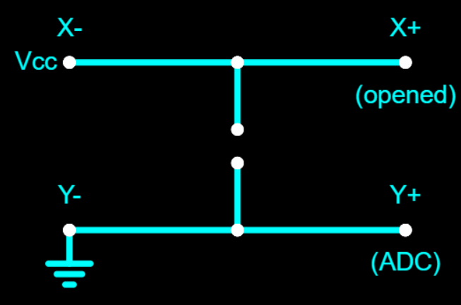
Display’s consumption
Internal circuit, turns off display
Touchscreen - sampling driven by touch interrupt

Slide 21
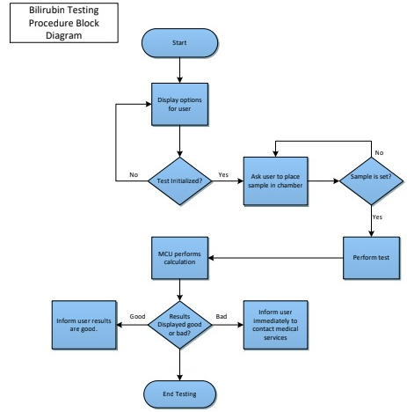
Flowchart

Slide 22
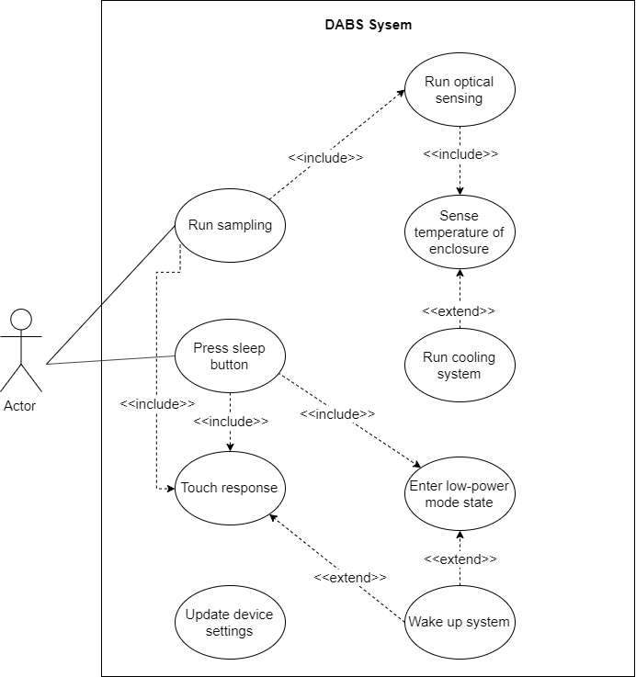
Use Case Diagram

Slide 23
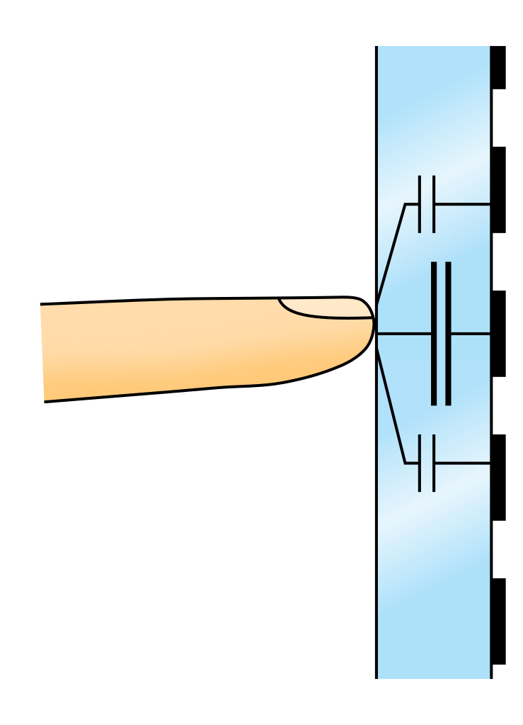
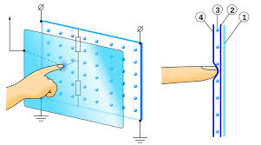
Touchscreen – Capacitive vs. Resistive
Resistive
Capacitive
Non multi-touch
Usable with gloves
Stylus compatible
Less sensitive to touch
Less expensive
Lacking in display quality
Multi-touch
Unusable with most gloves
Stylus incompatible
Sensitive to touch
More expensive
Responsiveness can vary per implementation in various products
Notes:
We picked resistive over capacitive because of out-of-the-box compatibility and low cost
The biggest differences being touch sensitivity, touch versatility, and multi-touch capability
Capacitive would have been nice option if we wanted the include multi-touch features

Slide 24
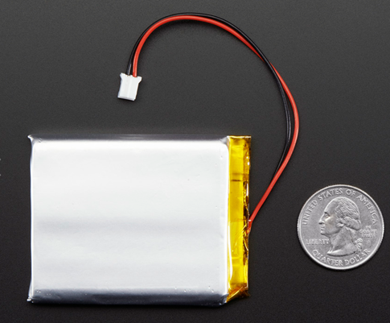
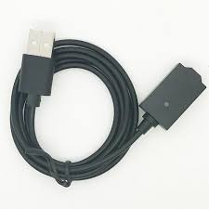
Power Input
Lithium-Ion Battery:
4.2 V Max @ full charge / 3.7 V nominal
2500 mAh capacity (10 Wh)
Adafruit - $14-15
USB Connection:
5 V Output
Will be used to charge the battery
Will supply power to the system when the battery is charging

Slide 25
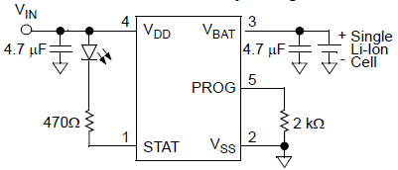
Battery Charging- TI’s MCP73831

Slide 26
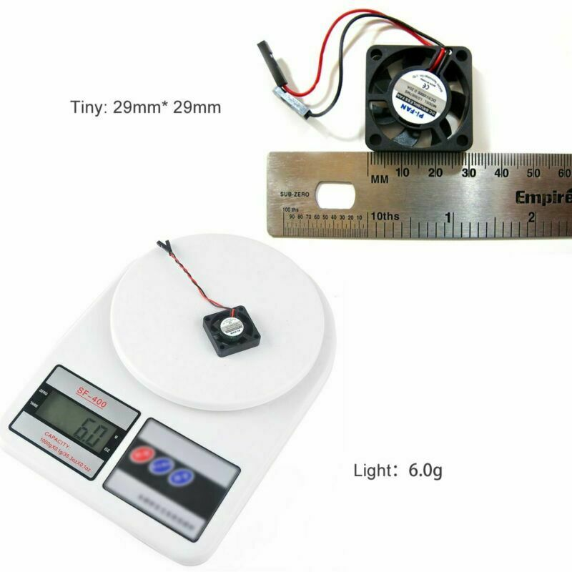
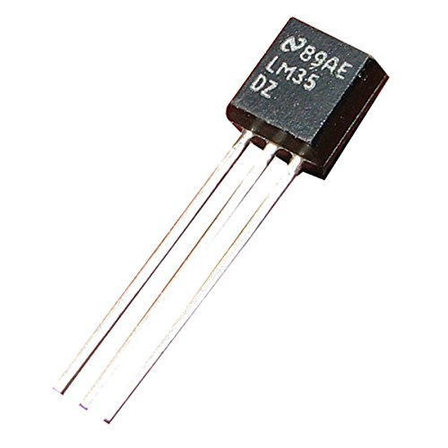
Other Components
Brushless Cooling Fan (x2)
Rated Voltage of 3.3 or 5 V
13000 RPM
180 mA
Amazon - $8
Temperature Sensor (TI LM35)
4 – 30 V
Range of -55°C to 150°C
< 60 uA current draw

Slide 27
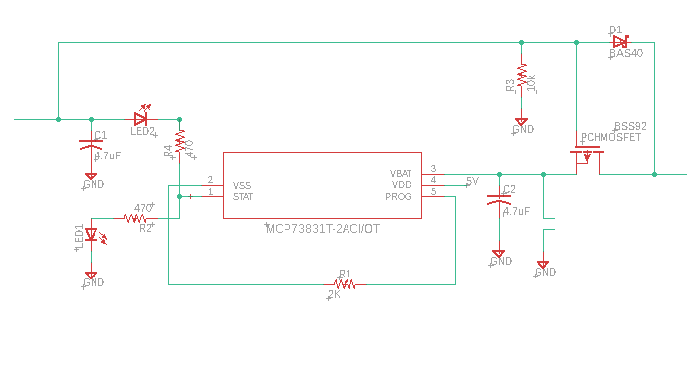
Battery Switching
USB Connection
(5V)
System
Battery

Slide 28
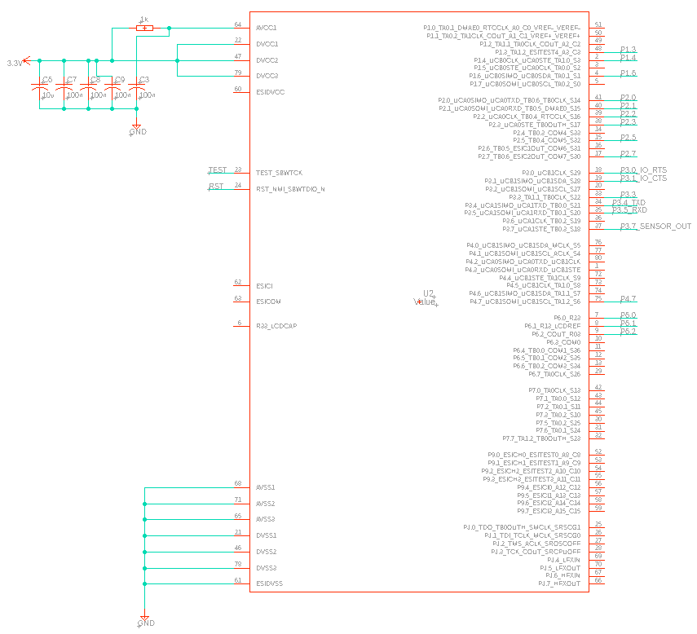
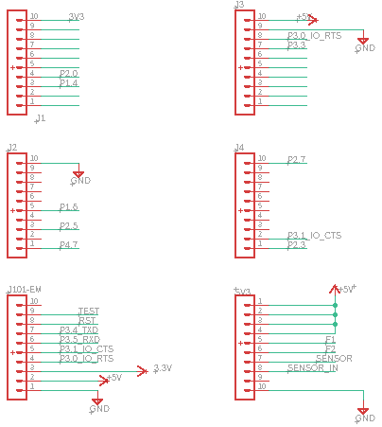
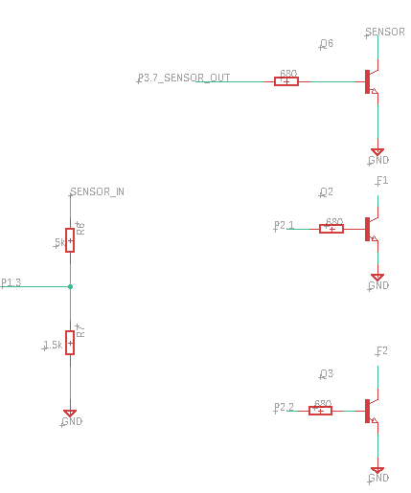
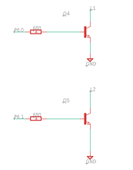
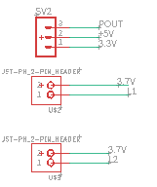
PCB Schematic
MCU-MSP430FR6989

Slide 29
PCB Schematic
LCD I/O

Slide 30
PCB Schematic
Emulator I/O

Slide 31
PCB Schematic
Cooling System
I/O

Slide 32
PCB Schematic
Optical Connections
Laser (2)
Photo Detector

Slide 33
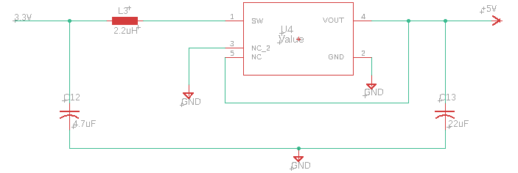
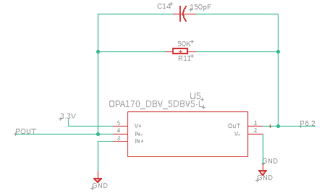
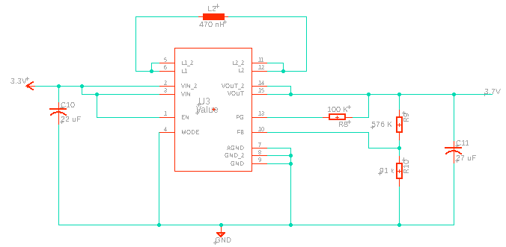
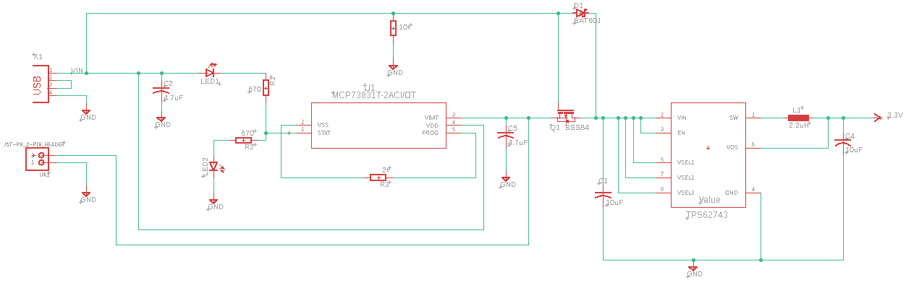
PCB Schematic
Amplifier Circuit

Slide 34


PCB Schematic
DC-DC Converters

Slide 35
PCB Schematic
Battery Charging Circuit

Slide 36
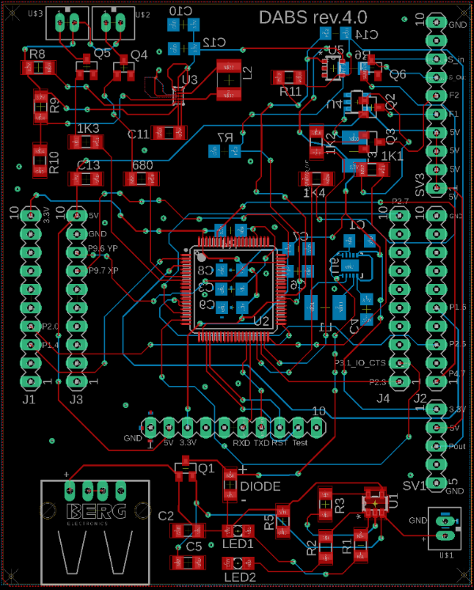
PCB Layout

Slide 37
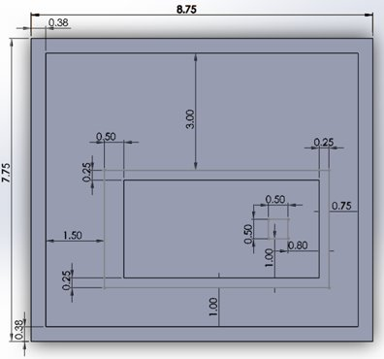
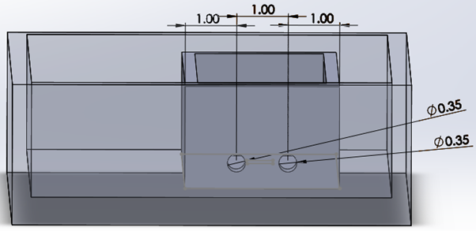
Optical Housing
Components: Lasers, cuvette holder, temperature sensor and detector
Lasers will be placed at an angle and must cross the front surface of the cuvette and reach the detector
All measurements are in inches
Top view w/inner and outer box dimensions
Inside view w/inner box dimensions

Slide 38
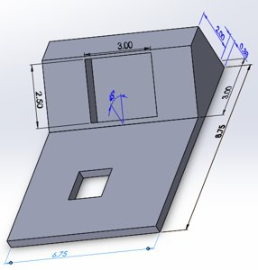
Outer Housing
Contain the PCB and other electronics such as the display and fans
Housing will be made using acrylic plastic which is lightweight, durable and easily machinable
All measurements are in inches​
Top view w/inner and outer box dimensions​
Lid of the housing w/respective measurements

Slide 39
Administrative Content

Slide 40
Project Budget
System | Part | Budgeted | Actual
Optical | Blue Laser Diode | $20 | $20
 | Green Laser Diode | $20 | $16
 | Cuvettes | $20 | $14
 | Photodetector | $50 | $15
 | OpAmp OPA170 | $5 | $0*
Power | Battery & Parts | $50 | $14
MCU and Screen | MSP430FR6989 80 Pin | $30 | $3
 | LCD Display | $100 | $26
PCB | Board | $50 | $40
 | BOM (Components) | $50 | $47
Temperature Control | Fan | $10 | $10
 | Temperature Sensor | $15 | $0*
Housing | Acrylic Plastic + Machine Work | $55 | $0*
Total |  | $475 | $205

Slide 41
Responsibilities
 | Andrea | Kevin K | Juan | Bernardin | Kevin L
Power |  | S | P
PCB |  | S | P
Light Source | P |  |  |  | S
Optical Alignment | P |  |  |  | P
Detector | S |  |  |  | P
Amplifier |  | P | S
MCU/Software |  | S |  | P
Display/ Touchscreen |  | S |  | P
Housing | S |  |  |  | P

Slide 42

Progress

Slide 43

Questions?

